Slide 1
Approve My Loan
By Lucis Han, Philippe Giang & Michael Fong

Slide 2
Proposal & Outline
Primary Objective
Our aim is to predict whether bank customers are eligible for home loans based on their personal & financial attributes.
Secondary Objective
Build a robot on AWS that advises the outcome of a customer’s loan being approved & recommend potential lenders.
Notes:
Philippe

Slide 3
Model Summary
Scikit-Learn
. Ensemble Learning: Random Forest Classifier
Can handle large data sets easily as our data set had 64,000 entries
Higher level of accuracy in predicting outcomes
. Easy Ensemble Classifier
Creates balanced samples of the training data set. This was relevant as our data set was skewed towards loan declines (25%) vs loan approvals (75%)
Notes:
Philippe

Slide 4
Model Summary cont…
. Logistic Regression
Determine the relationship between the dependent variable (loan approval) and the independent variables
. Random Oversampling
Able to supplement a minority class (loan declines)
. Undersampling: Cluster Centroids
Replace a cluster of data points in the Majority sample by the Cluster Centroid.
. SMOTE Oversampling
Create synthetic data points based on the original data points (no duplicate)
Notes:
Philippe

Slide 5
Data Cleanup & Model Training
Data Review
Data was sourced from Kaggle using existing loan analysis projects
Data source contained 64,000 entries with 45 columns
Remove nulls
Removed irrelevant columns and kept pertinent data
Notes:
Lucis

Slide 6
Data Cleanup & Model Training cont …
Training
70% to training and 30% to testing
Feature engineering: Cleanup and dropping columns
Notes:
Lucis

Slide 7
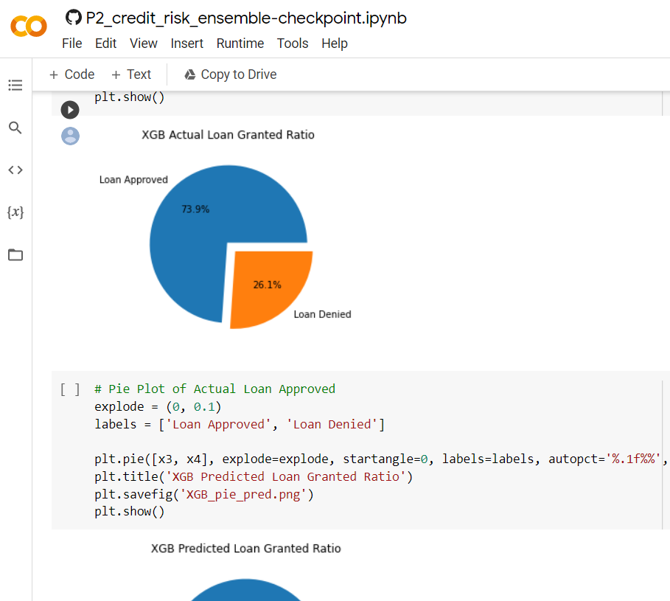
Colab integration
Notes:
Lucis

Slide 8
Model Evaluation
Feature Importances
Confusion Matrix
Balanced Accuracy Score
AUC-ROC
Classification Report
Cross Validation
Visualisation
Notes:
Lucis

Slide 9
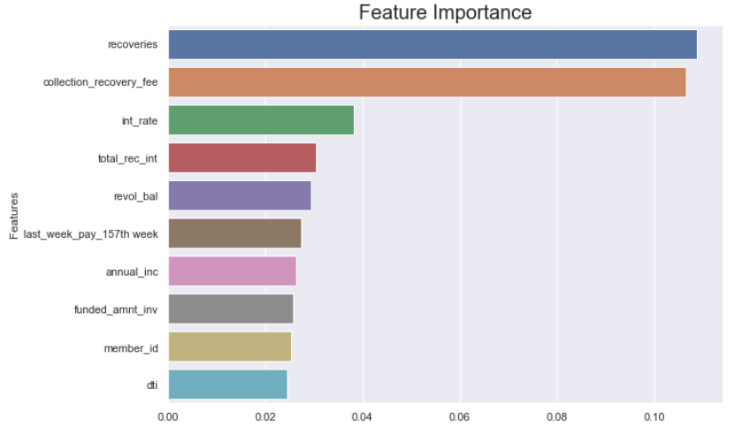
Model Evaluation
Feature Importance

Slide 10
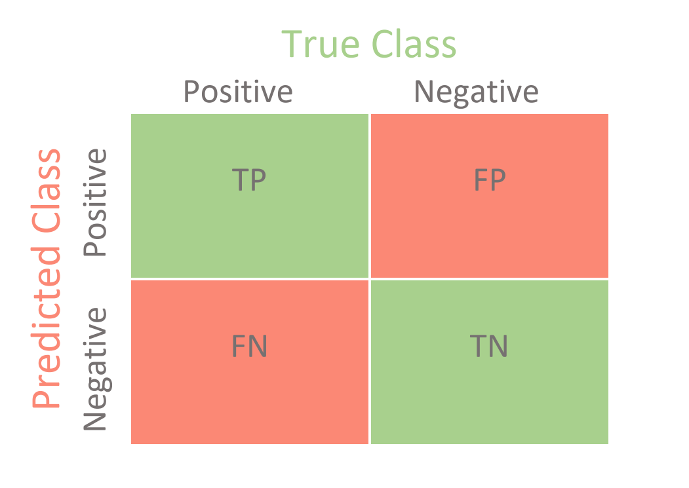
Model Evaluation
Confusion Matrix
Visual Classification to visualize the performance of an algorithm
Notes:
Philippe

Slide 11
Model Evaluation
Confusion Matrix
Visual Classification to visualize the performance of an algorithm
Balanced Accuracy Score
Score to assess how well the machine learning algorithm predicts the outcome.
Balanced Accuracy Score = ( TP / ( TP + FP ) + TN / ( FN + TN ) ) / 2
Notes:
Philippe

Slide 12
Model Evaluation
Example with our own machine learning
A | Balanced Random Forest
 | Predicted Approve | Predicted Deny
Actual Approve | 141 | 48
Actual Deny | 95 | 441
Balanced Accuracy Score = ( 141 / (141 + 48) + 441 / ( 441 + 95 ) ) / 2
Balanced Accuracy Score = 0.784396
Notes:
Philippe

Slide 13
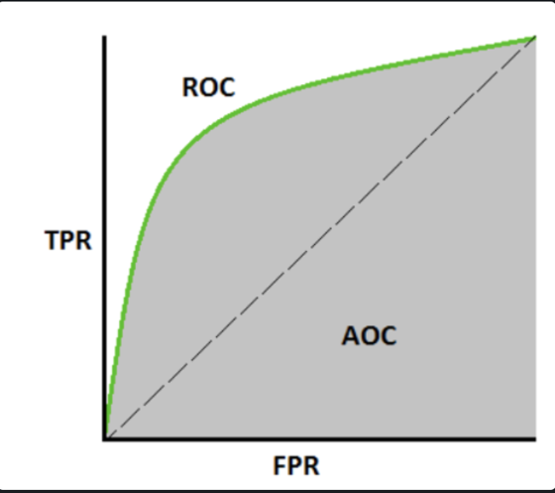
Model Evaluation
ROC Curves summarize the trade-off between the true positive rate and false positive rate for a predictive model using different probability thresholds.

Slide 14
Model Evaluation
Classification Report: The Most Important values for this test
Precision:
Of all loans that the machine predicted as approved, how many actually got approved?
Recall:
Of all loans that were truly approved, how many did we predict?
Possibly:
F1 Measure:
Harmonic Mean between Precision and Recall
Decrease undesirable false Approval and false Rejection
Notes:
Philippe

Slide 15
Model Evaluation
Classification Report: Other indicators
Specificity:
Not ideal for a Loan approval machine learning with low rate of negative approval
Recall:
Of all loans that were truly approved, how many did we predict?
Geometric Mean:
used in finance to calculate average growth rates, not applicable for today
Index of Balanced Accuracy
Dependant on Specificity
Notes:
Philippe

Slide 16
Loan Acceptance / Decline for each model
A = Balanced Random Forest
B = Easy Ensemble Classifier
C = Logistic Regression
D = Naive Random Oversampling
E = SMOTE Oversampling
F = Cluster Centroids
G = SMOTE-EEN
H = XGBoost
 | A | B | C | D | E | F | G | H | Actual
Accepted | 67.40% | 66.20% | 91.50% | 75.60% | 75.60% | 67.90% | 73.90% | 84.30% | 73.90%
Declined | 32.60% | 33.80% | 8.50% | 24.40% | 24.40% | 32.10% | 26.10% | 15.70% | 26.10%
Notes:
Michael

Slide 17
Balanced Accuracy Score
A = Balanced Random Forest
B = Easy Ensemble Classifier
C = Logistic Regression
D = Naive Random Oversampling
E = SMOTE Oversampling
F = Cluster Centroids
G = SMOTE-EEN
H = XGBoost
 | A | B | C | D | E | F | G | H
Score | 0.784396 | 0.784396 | 0.682203 | 0.702919 | 0.697897 | 0.714742 | 0.678960 | 0.726442
Ranking | 1 | 1 | 7 | 5 | 6 | 4 | 8 | 3
Notes:
Michael
5
Balanced accuracy is a metric that one can use when evaluating how good a binary classifier is. It is especially useful when the classes are imbalanced, i.e. one of the two classes appears a lot more often than the other. This happens often in many settings such as anomaly detection and the presence of a disease

Slide 18
Precision Comparison
A = Balanced Random Forest
B = Easy Ensemble Classifier
C = Logistic Regression
D = Naive Random Oversampling
E = SMOTE Oversampling
F = Cluster Centroids
G = SMOTE-EEN
H = XGBoost
 | A | B | C | D | E | F | G | H
0 | 0.60 | 0.57 | 1.00 | 1.00 | 0.50 | 0.39 | 0.40 | 0.82
1 | 0.90 | 0.90 | 0.87 | 0.87 | 0.88 | 0.91 | 0.88 | 0.84
avg / total | 0.82 | 0.81 | 0.90 | 0.90 | 0.81 | 0.81 | 0.79 | 0.83
Notes:
Michael

Slide 19
Index Balanced Accuracy Comparison
A = Balanced Random Forest
B = Easy Ensemble Classifier
C = Logistic Regression
D = Naive Random Oversampling
E = SMOTE Oversampling
F = Cluster Centroids
G = SMOTE-EEN
H = XGBoost
 | A | B | C | D | E | F | G | H
0 | 0.61 | 0.59 | 0.34 | 0.34 | 0.44 | 0.51 | 0.44 | 0.45
1 | 0.62 | 0.59 | 0.39 | 0.39 | 0.47 | 0.51 | 0.46 | 0.49
avg / total | 0.62 | 0.59 | 0.38 | 0.38 | 0.47 | 0.51 | 0.46 | 0.48
Notes:
Michael

Slide 20
Recall Comparison
A = Balanced Random Forest
B = Easy Ensemble Classifier
C = Logistic Regression
D = Naive Random Oversampling
E = SMOTE Oversampling
F = Cluster Centroids
G = SMOTE-EEN
H = XGBoost
 | A | B | C | D | E | F | G | H
0 | 0.75 | 0.74 | 0.36 | 0.36 | 0.53 | 0.69 | 0.57 | 0.49
1 | 0.82 | 0.80 | 1.00 | 1.00 | 0.87 | 0.73 | 0.79 | 0.96
avg / total | 0.80 | 0.78 | 0.87 | 0.87 | 0.80 | 0.73 | 0.75 | 0.84
Notes:
Michael

Slide 21
F1 measure Comparison
A = Balanced Random Forest
B = Easy Ensemble Classifier
C = Logistic Regression
D = Naive Random Oversampling
E = SMOTE Oversampling
F = Cluster Centroids
G = SMOTE-EEN
H = XGBoost
 | A | B | C | D | E | F | G | H
0 | 0.66 | 0.64 | 0.53 | 0.53 | 0.51 | 0.50 | 0.47 | 0.61
1 | 0.86 | 0.85 | 0.93 | 0.93 | 0.88 | 0.81 | 0.83 | 0.90
avg / total | 0.81 | 0.80 | 0.85 | 0.85 | 0.81 | 0.75 | 0.76 | 0.82
Notes:
Michael

Slide 22
Specificity Comparison
A = Balanced Random Forest
B = Easy Ensemble Classifier
C = Logistic Regression
D = Naive Random Oversampling
E = SMOTE Oversampling
F = Cluster Centroids
G = SMOTE-EEN
H = XGBoost
 | A | B | C | D | E | F | G | H
0 | 0.82 | 0.80 | 1.00 | 1.00 | 0.87 | 0.73 | 0.79 | 0.96
1 | 0.75 | 0.74 | 0.36 | 0.36 | 0.53 | 0.69 | 0.57 | 0.49
avg / total | 0.77 | 0.76 | 0.49 | 0.49 | 0.59 | 0.70 | 0.61 | 0.61
Notes:
Michael

Slide 23
Geometric Mean Comparison
A = Balanced Random Forest
B = Easy Ensemble Classifier
C = Logistic Regression
D = Naive Random Oversampling
E = SMOTE Oversampling
F = Cluster Centroids
G = SMOTE-EEN
H = XGBoost
 | A | B | C | D | E | F | G | H
0 | 0.78 | 0.77 | 0.60 | 0.60 | 0.68 | 0.71 | 0.67 | 0.69
1 | 0.78 | 0.77 | 0.60 | 0.60 | 0.68 | 0.71 | 0.67 | 0.69
avg / total | 0.78 | 0.77 | 0.60 | 0.60 | 0.68 | 0.71 | 0.67 | 0.69
Notes:
Michael

Slide 24
Index Balanced Accuracy Comparison
A = Balanced Random Forest
B = Easy Ensemble Classifier
C = Logistic Regression
D = Naive Random Oversampling
E = SMOTE Oversampling
F = Cluster Centroids
G = SMOTE-EEN
H = XGBoost
 | A | B | C | D | E | F | G | H
0 | 0.61 | 0.59 | 0.34 | 0.34 | 0.44 | 0.51 | 0.44 | 0.45
1 | 0.62 | 0.59 | 0.39 | 0.39 | 0.47 | 0.51 | 0.46 | 0.49
avg / total | 0.62 | 0.59 | 0.38 | 0.38 | 0.47 | 0.51 | 0.46 | 0.48
Notes:
Michael

Slide 25
Discussion cont …
And the winner is…
. Highest BAS - Balanced Random Forest & Easy Ensemble Classifier
. Best Precision - Logistic Regression & Naive Random Oversampling
. Best Recall - Logistic Regression & Naive Random Oversampling
Top 3 features
Recoveries at 0.1086
Collection Recovery Fee at 0.1064
Interest Rate at 0.0383
Notes:
Michael
. Balanced Random Forest incorporates weights into the classifier meaning it penalises misclassifying the minority class. It also combines the sampling technique and ensemble learning therefore downsampling the majority class and growing trees on a more balanced data set. This was particularly useful when dealing with our imbalanced data set of loan approvals and declines.
. Easy Ensemble Classifier created balanced samples of the data set.

Slide 26
Post Mortem
Difficulties
Computing power: Unable to run algorithm across the entire library
Locating a data set
Given 2 extra weeks
Sourcing another data set and running that through the same models
Loan approver bot on AWS that determines loan approval confidence and recommends lenders to the customer.
Notes:
All

Slide 27
Limitations
Limitations Observed
Availability of data - limited customer data information in a large enough sample size
Randomising data - possibility if we were unable to find a reliable data set
Had to reduce the size of the data set from 64,000 to 2,400 due to memory limitations
Had to increase the size of the loan amount to mimic actual loan data
Data source was from the US and not Australia. Lending criteria will be different

Slide 28
Questions?
Notes:
All

